Slide 1
QUERY BEFORE MUTATION
GUARDRAIL PATTERNS FOR AGENTS THAT TOUCH PRODUCTION INFRASTRUCTURE
Presenter: Jeffrey Aven
STACKQL>>

Slide 2
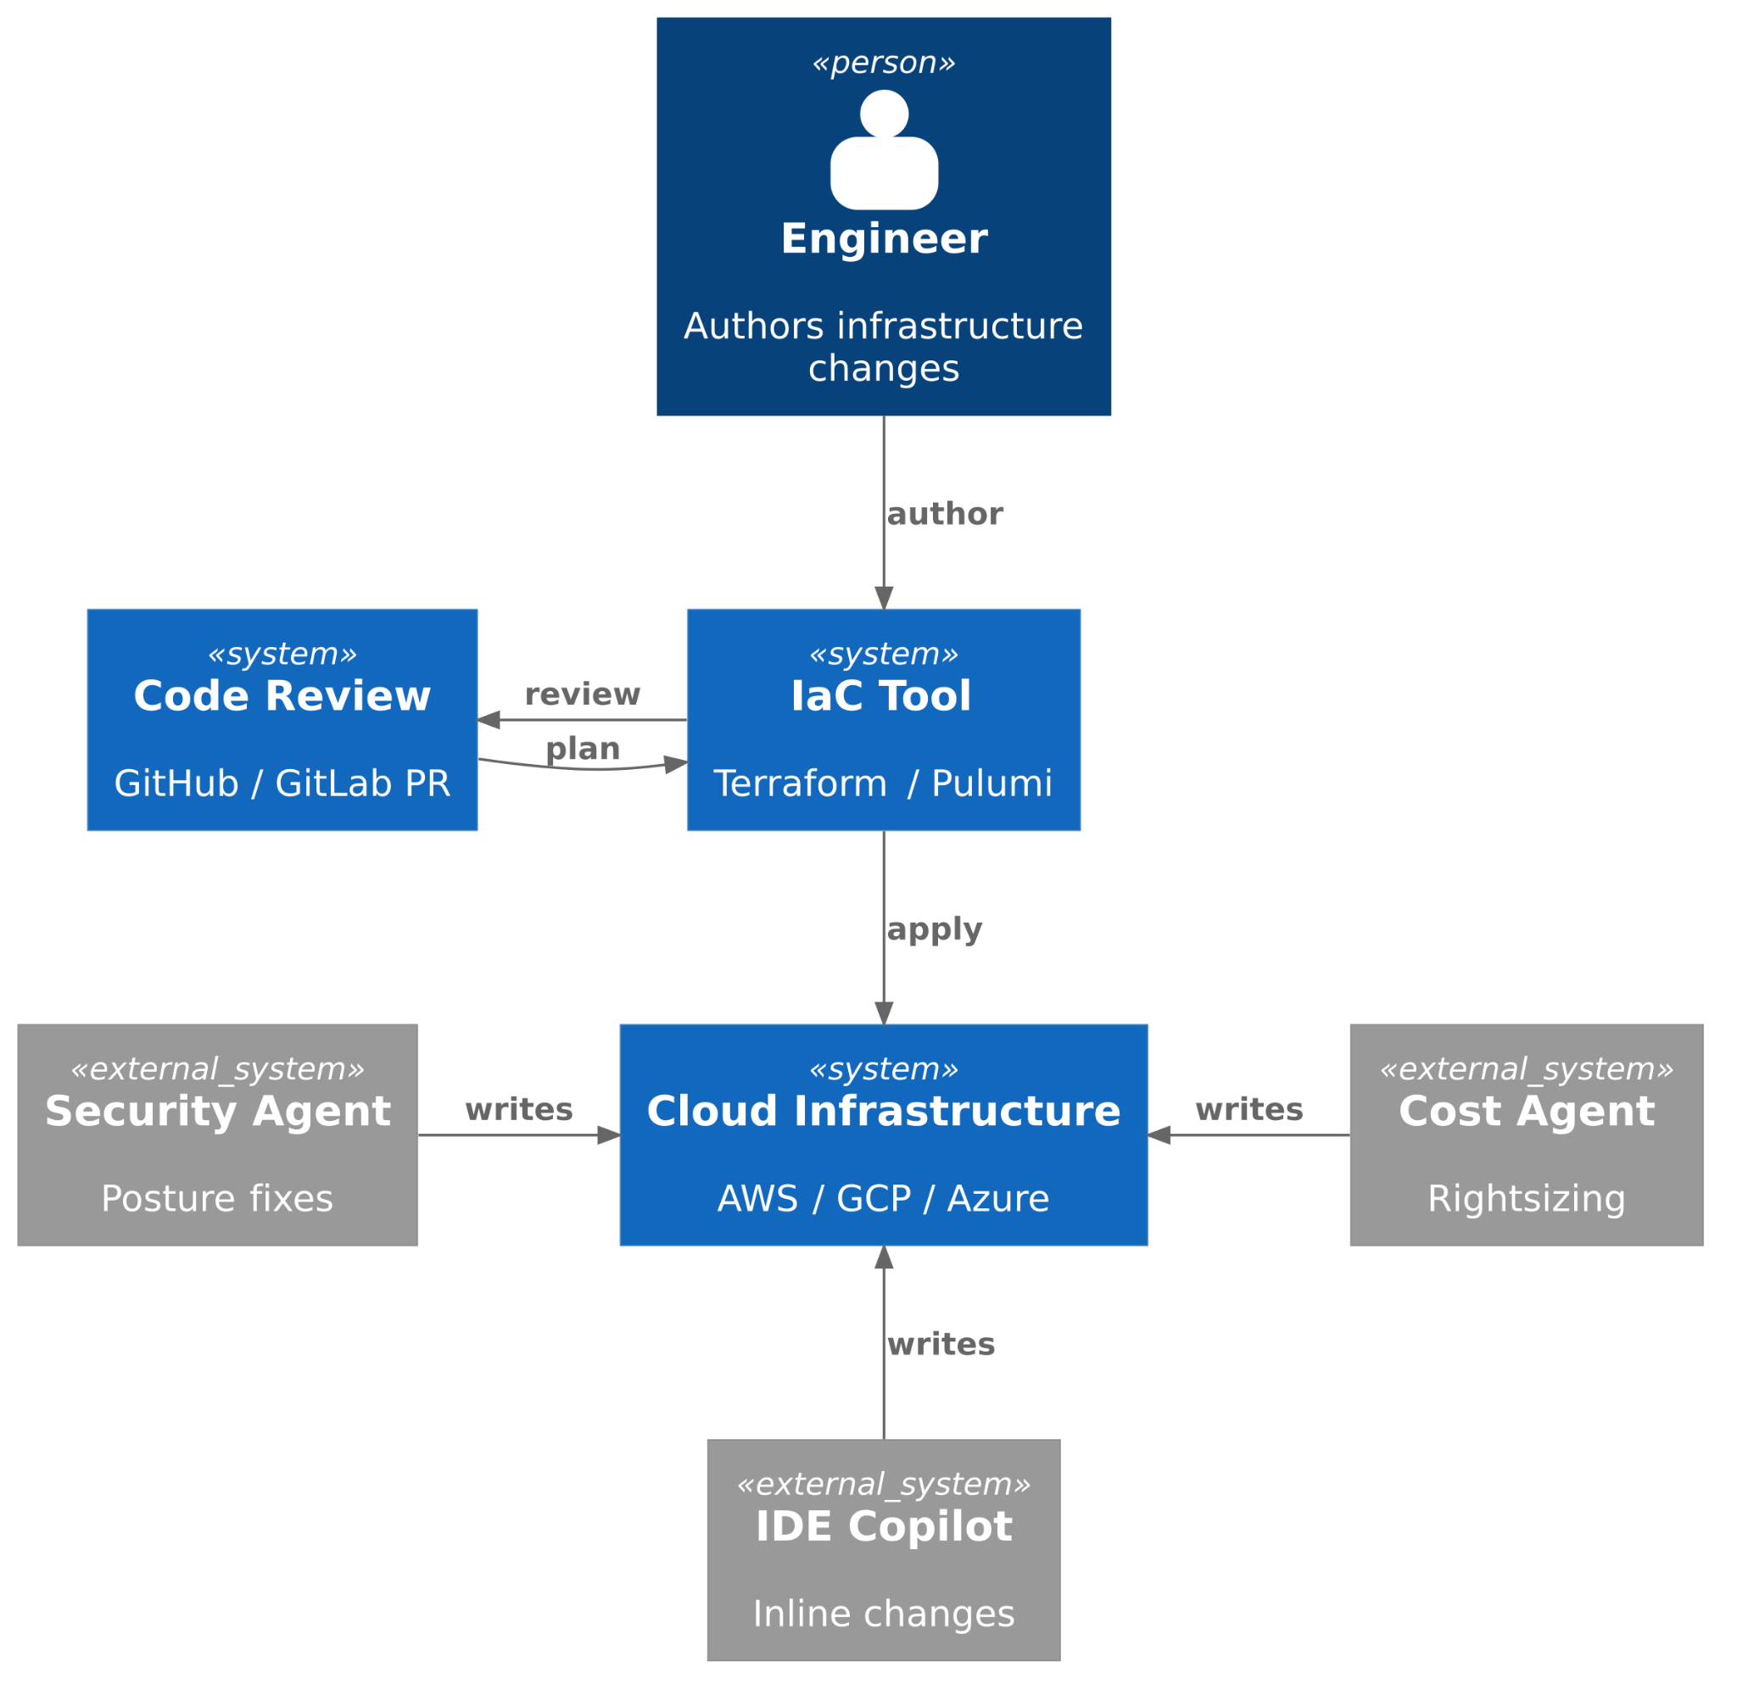

AI CHANGES EVERYTHING
Agents AND humans can author changes.
Changes at machine speed.
Multiple writers, at the same time.
Drift is the default state.
STACKQL>>
Notes:
Every one of the 2015 assumptions inverts under agents: agents and humans both author changes, at machine speed, many writers at once, and drift is the default state.
The thing that made plan-and-apply safe was a human pause between the plan and the apply. Give an agent write permission and that pause is gone.

Slide 3
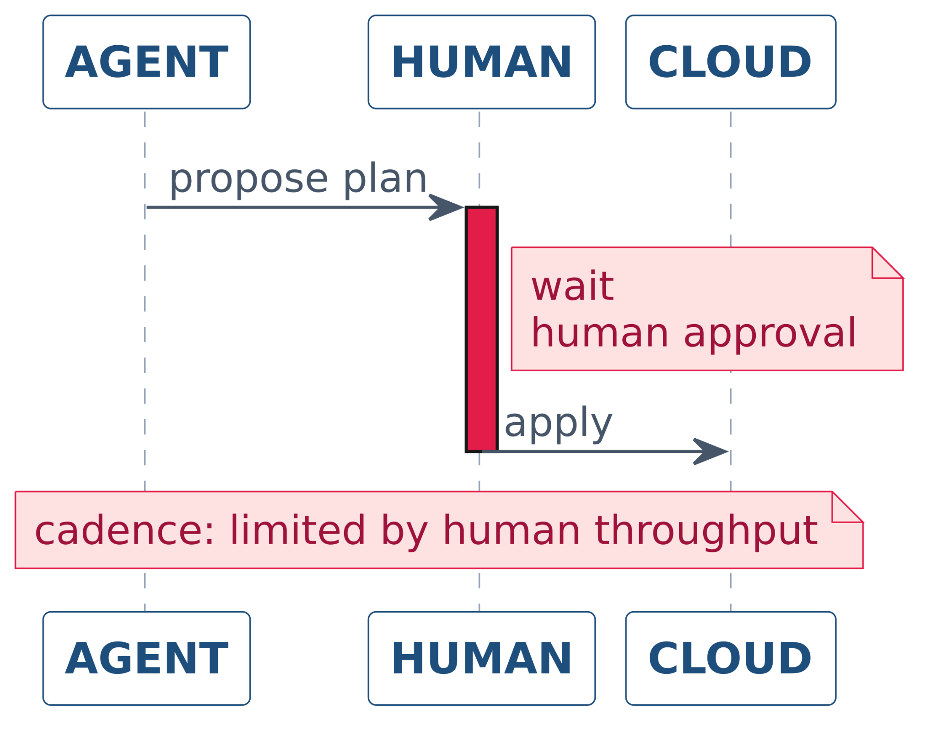
PLAN AND APPLY EXPECTS A HUMAN
The review cycle is the safety mechanism.
Agents operate outside the loop.
Safety can't depend on humans.
STACKQL>>
Notes:
The review cycle was doing the safety work: a human looked at the plan, saw something off, and stopped the apply.
Agents do not stop. They proceed, and they retry.
So the judgement has to move out of the meeting and into the system: policy and assertion, not inspection. That is the rest of this talk.

Slide 4
FIVE GUARDRAILS
PUT THE JUDGEMENT BACK IN THE SYSTEM
01 - QUERY BEFORE MUTATION
02 - IDEMPOTENT ASSERTIONS
03 - POLICY GATES
04 - SCOPED CREDENTIALS AND SURFACES
05 - RECOVERY PATHS
STACKQL>>
Notes:
Five guardrails. None of them is new on its own; together they put the judgement back into the system.
The first is the title of the talk, and the cheapest to adopt.

Slide 5
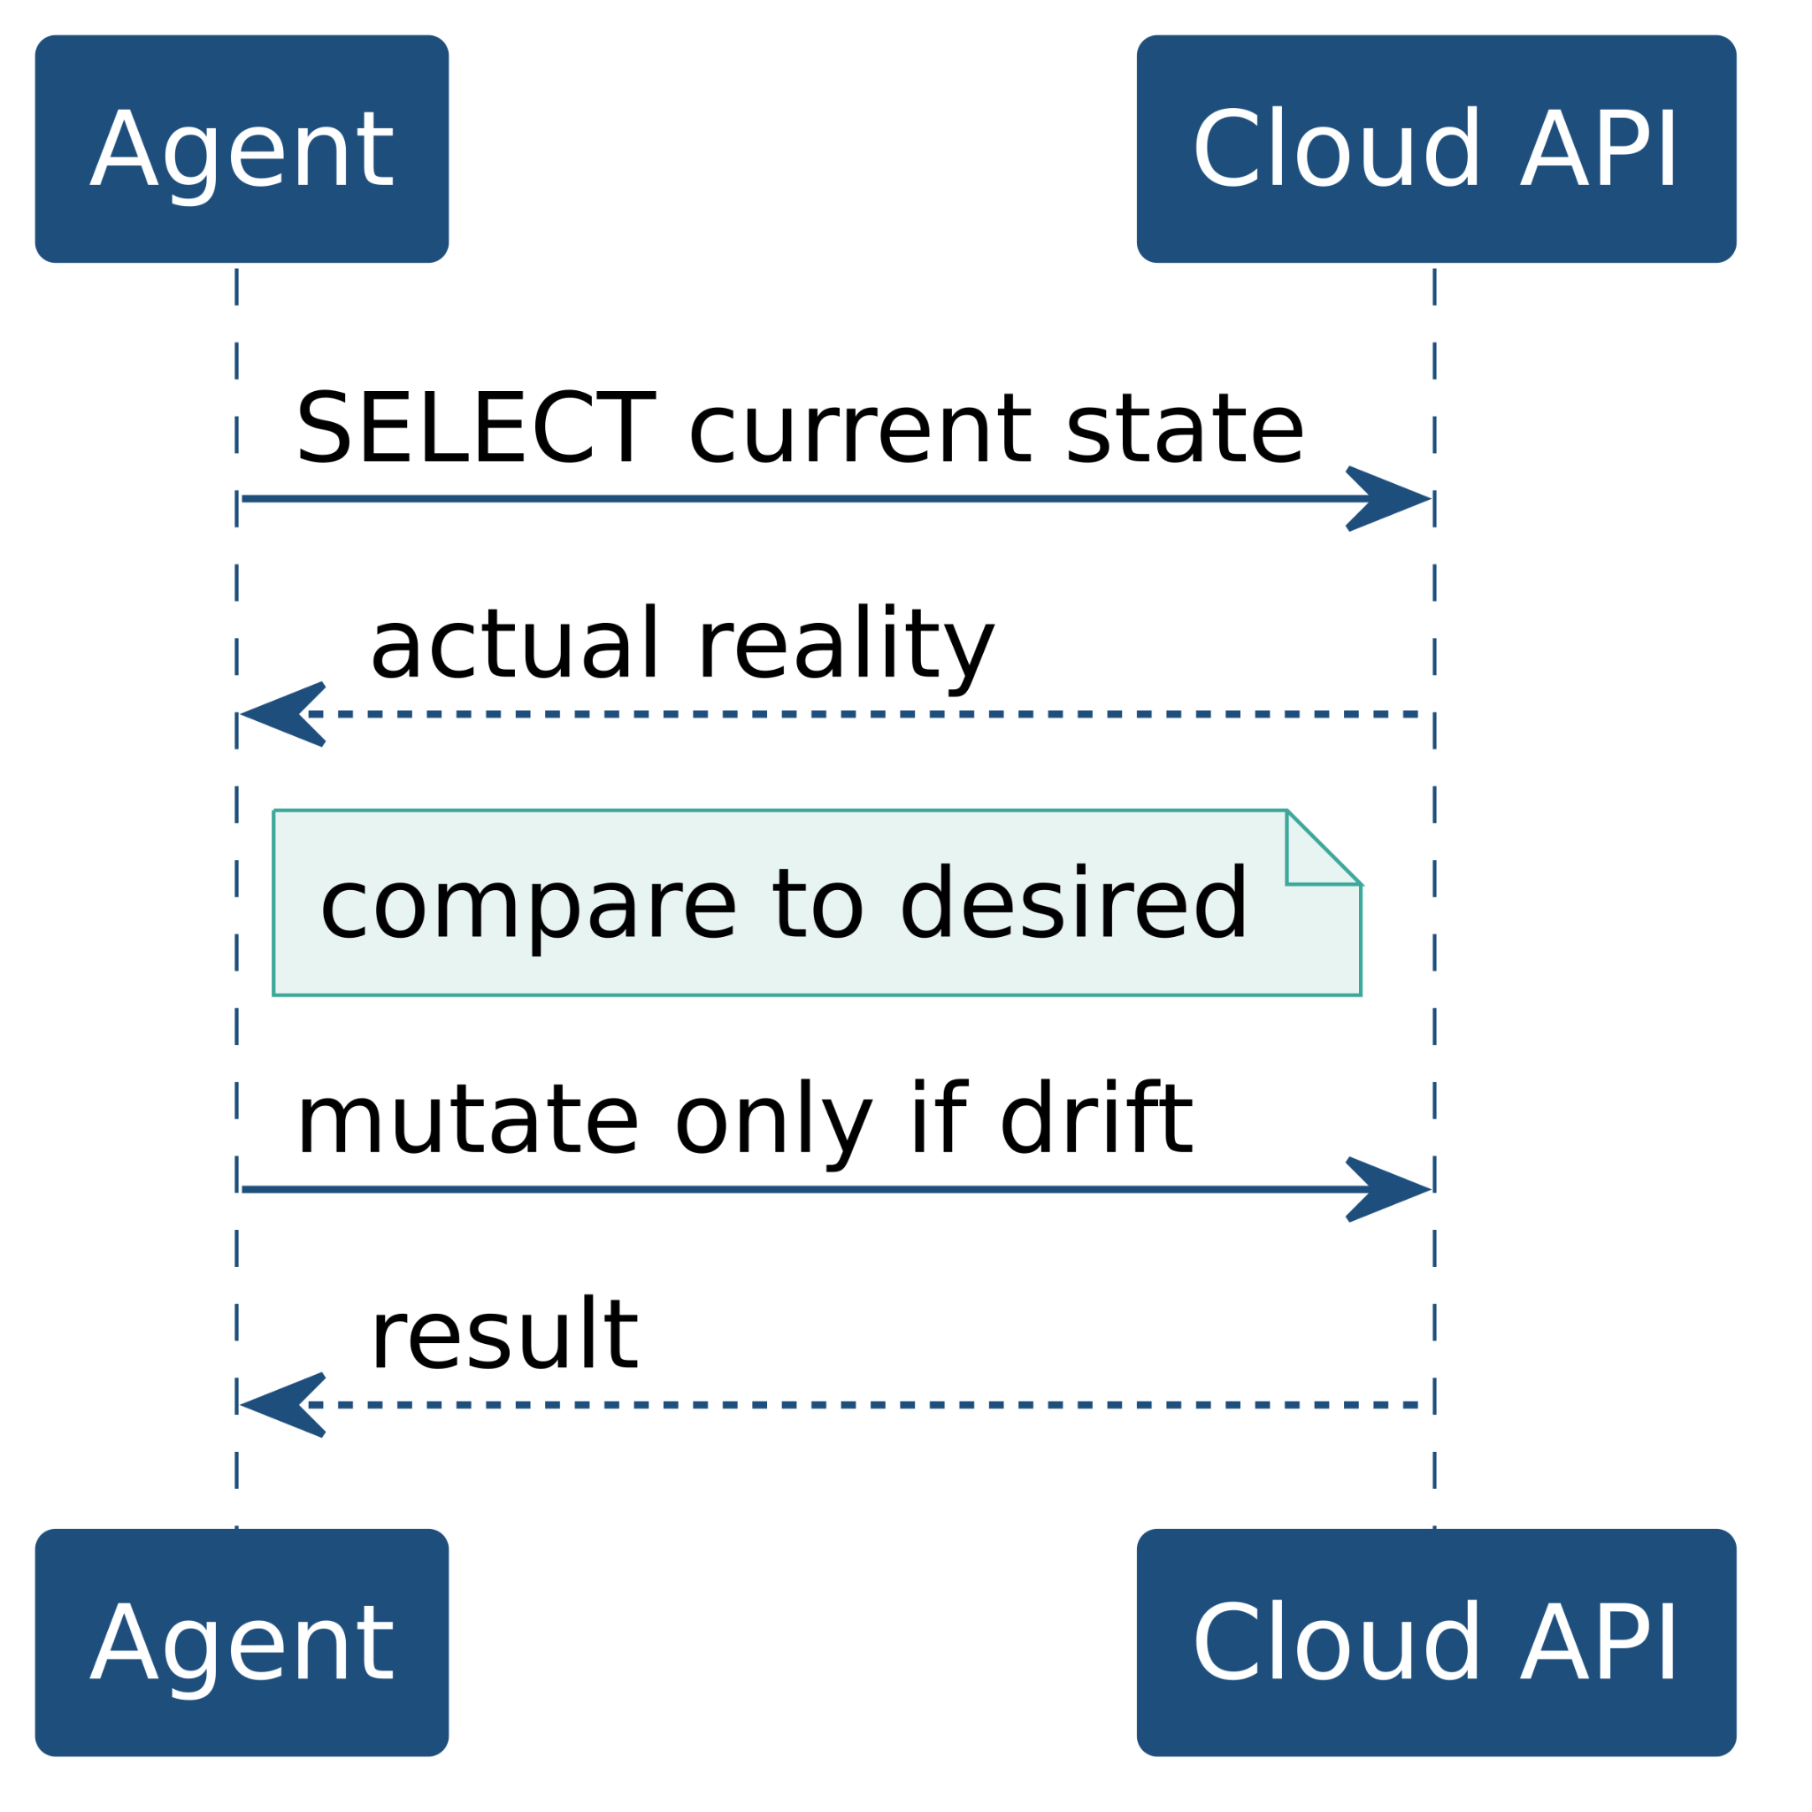
01
QUERY BEFORE MUTATION
Inspect reality, not the state file, before acting.
“A state file shows what a tool wrote last run. The cloud API shows what actually exists. Autonomous agents should read live state on every decision.”
STACKQL>>
Notes:
Read the live state on every decision, not the state file, not a cache from ten minutes ago.
Read the declaration too, and its history: drift is a difference between what is live and what was declared, and between when each last changed.
The cheapest pattern to adopt and the one that prevents the most damage.

Slide 6
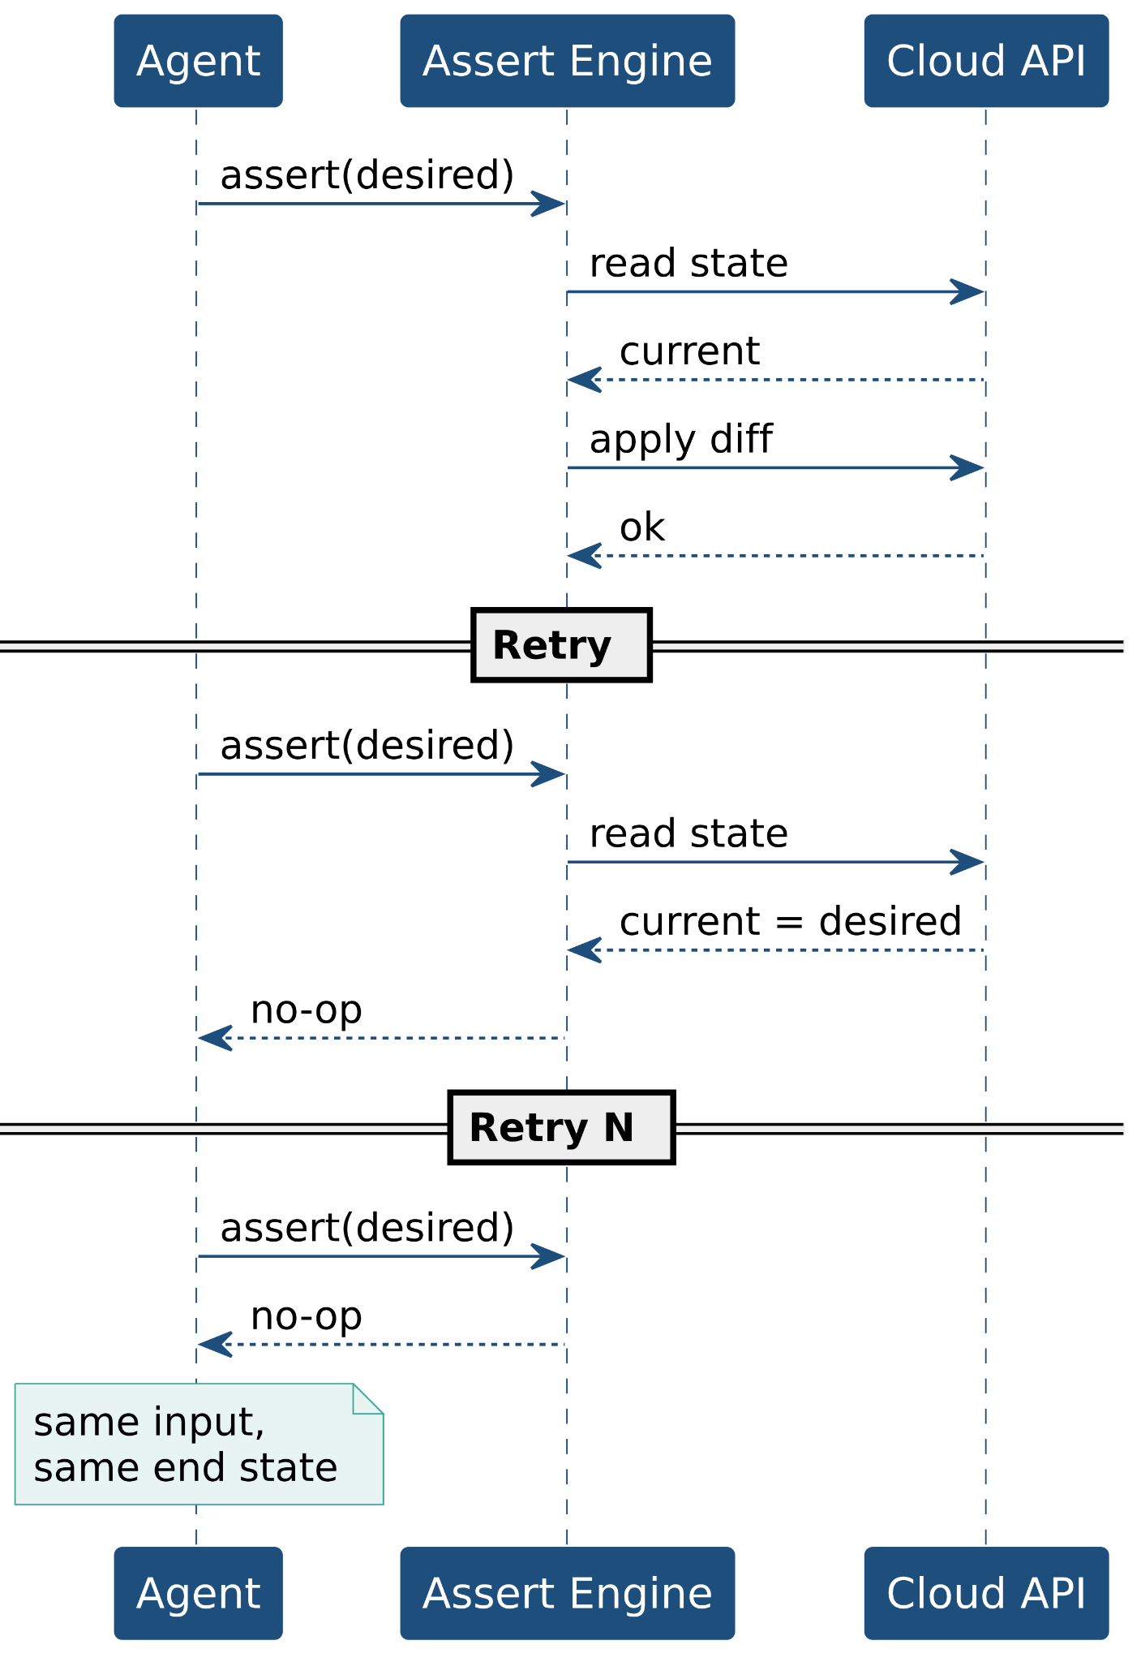
02
IDEMPOTENT ASSERTIONS
Idempotent assertions, not imperative scripts.
“Agents retry and resume by default. If every call asserts desired state, every attempt converges on the same end state and the agent does not have to remember what it did.”
STACKQL>>
Notes:
Declare what should be, not how to get there. Retries, re-runs and partial failures all converge on the same state.
In the demo the agent's one permitted write is the same assertion the build runs. A retry is safe by construction.
The limit: it converges to the declaration. If the declaration is wrong, it converges to the wrong thing faster.

Slide 7
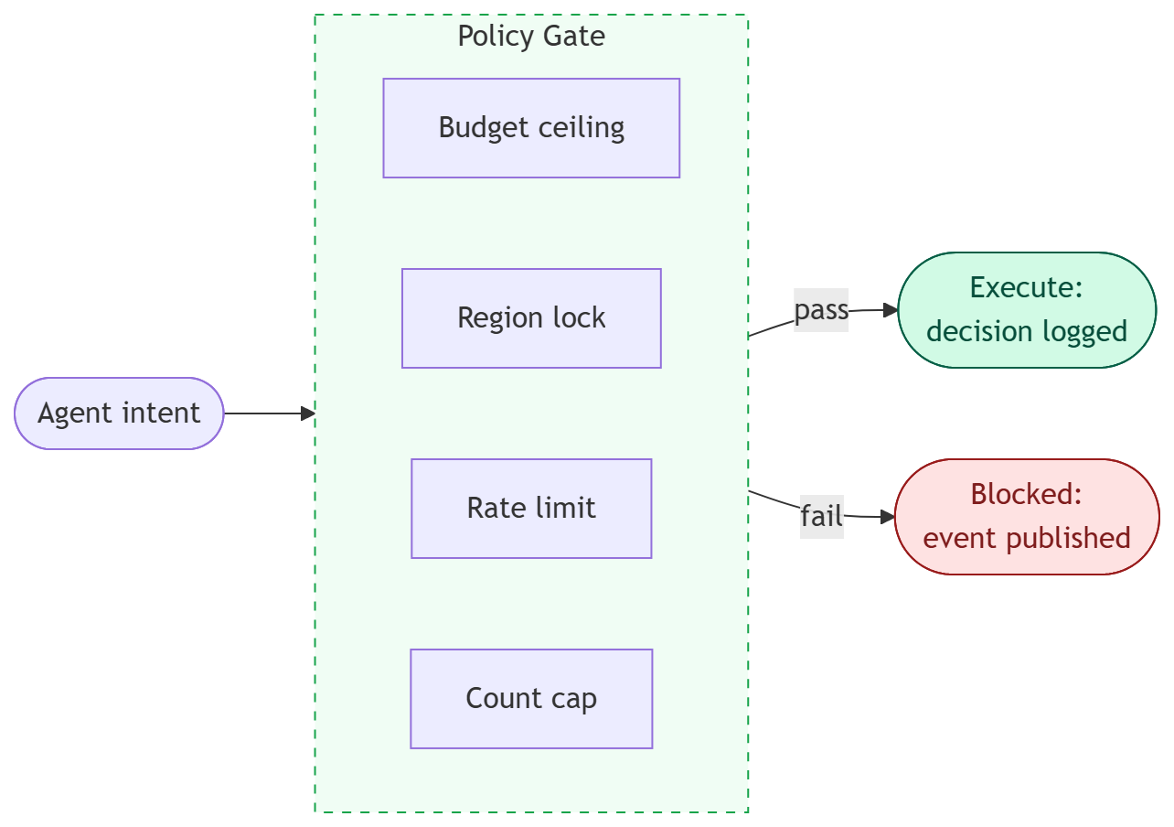
03
POLICY GATES REPLACE REVIEW CYCLES
Machine-checkable, owned by the platform
"The review cycle bounded what humans could do by accident. In the agent era, execution bounds do the same job by design: budget ceilings, region locks, change rate limits, resource count caps. Policy is not a compliance artefact. It is the new safety loop."
STACKQL>>
Notes:
Human review was the safety loop. Agents bypass it by design, so something has to replace it.
Policy gates are that replacement: rules evaluated in code against the proposed change, before it runs. Deterministic, testable, and they cannot be talked out of a decision.
In the demo there are three gates in series, and none of them is the model's: a policy function, the server mode, and a human bound to the exact statement.
The limit: a policy is only as good as its rules. A rule that permits a bad write permits it every time.

Slide 8
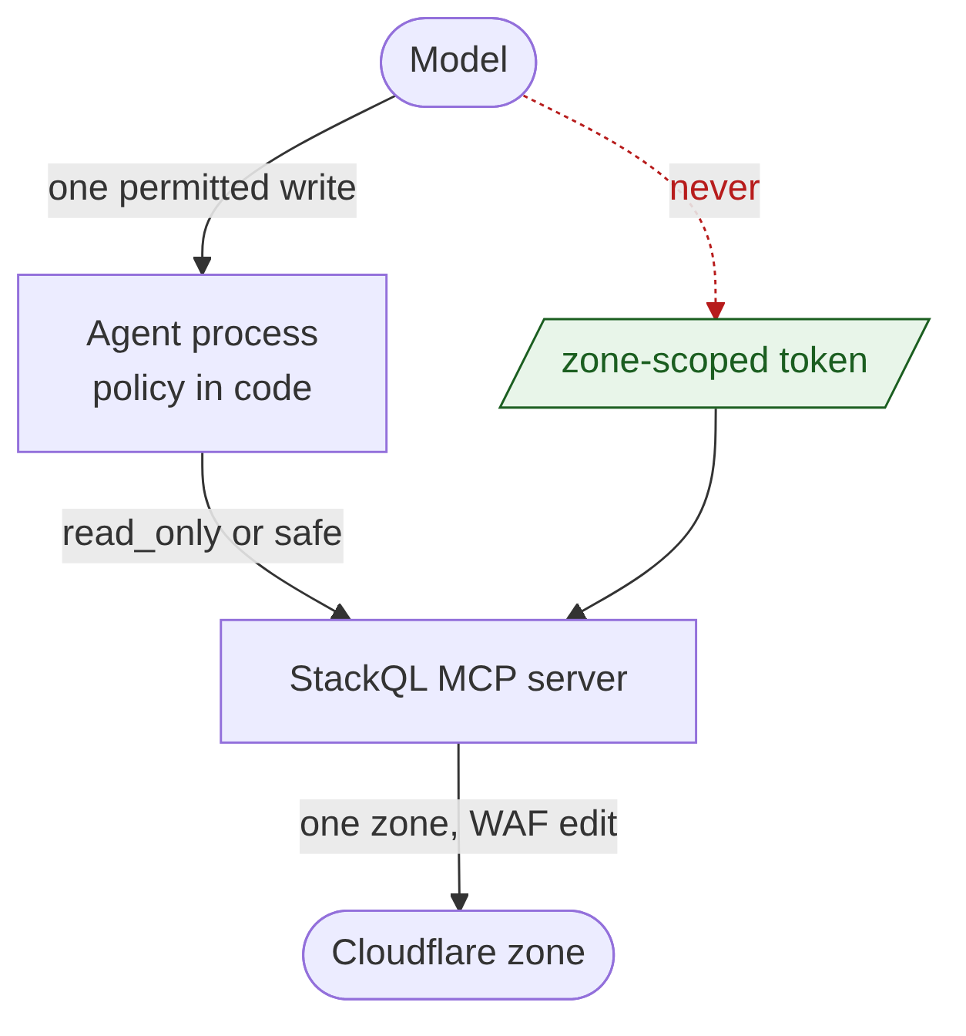
04
SCOPED CREDENTIALS AND SURFACES
The model proposes. It never holds the key.
"The agent's blast radius is whatever its credential can reach and whatever its tools will write. Scope the credential to the one zone, hold it in the server process, and give the model one statement it is allowed to make. The policy checks that statement field for field; the credential is the backstop if the policy is wrong."
STACKQL>>
Notes:
Two bounds on the damage a wrong decision can do, whoever made it.
The credential: scoped to one zone, WAF edit only, held by the MCP server process. The model never sees it.
The surface: one REPLACE on one resource, rendered by the platform from the declaration and given to the model verbatim. Anything else is declined before it leaves the process.
The limit: a broad token makes every other guardrail advisory.

Slide 9
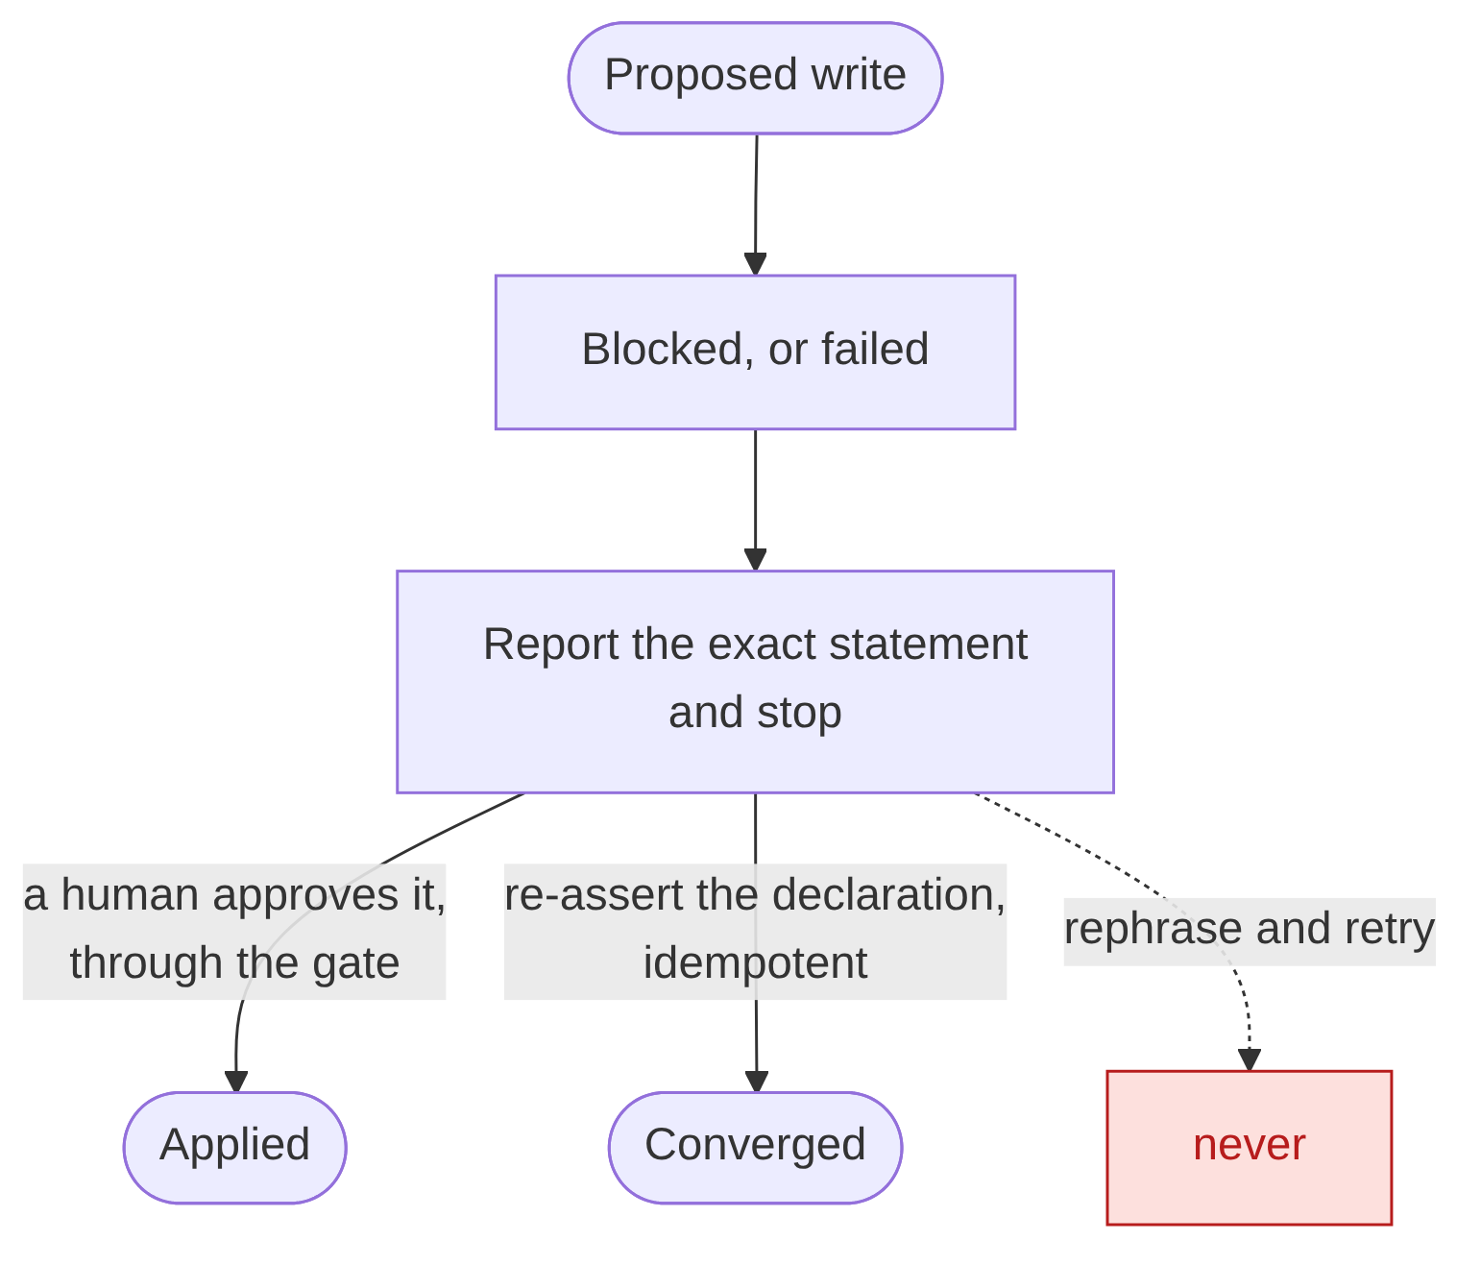
05
RECOVERY PATHS
Blocked is a report, not a retry.
"A blocked write is the system working. The agent reports the exact statement and stops; it does not rephrase it and try again. Recovery is a human replaying that statement through the gate, or the declaration re-asserted. A failed write recovers the same way, because the assertion is idempotent."
STACKQL>>
Notes:
Blocked and failed changes need a defined next step, or the agent invents one.
Blocked: report the exact statement, stop. Two ways back: a human approves that statement through the gate, or the declaration is re-asserted. The demo shows both.
Failed or unknown outcome: re-read, then re-assert. Never a blind retry.
The limit: an approval at a terminal is not an authenticated, audited approval service.

Slide 10
DEMO
STACKQL>>
Notes:
One Cloudflare zone, one rate limit rule declared in a stackql-deploy manifest: 100 requests per 10 seconds. At 3am someone tightened it to 5 in the dashboard and left a note.
Beats: the zone in SQL (live rule, declaration history on GitHub, out_of_band in one query); the agent in read_only (reads, diagnoses, proposes one write, refused, stops); the same proposal through the gate in safe mode (policy, approval, applied); a write that is not the declaration (declined by policy, nobody asked); the audit log.
Say which mode the server is in before each run.

Slide 11
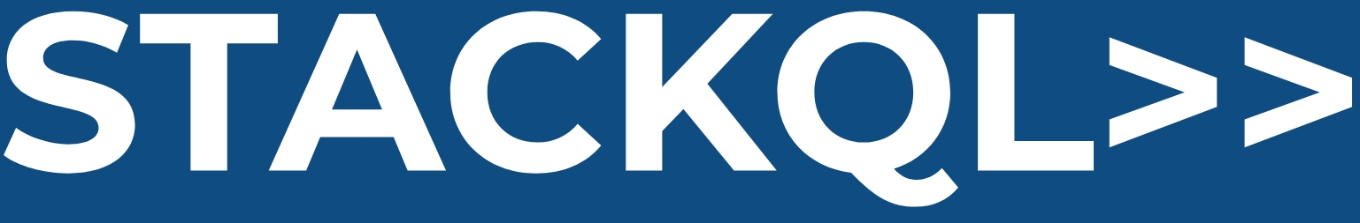
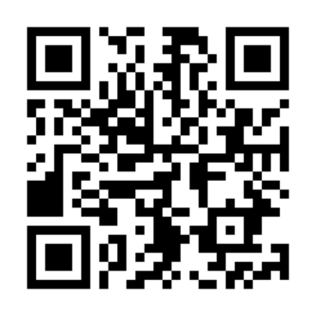

CLOUD
COMPLIANCE
SECURITY
MCP
AUTOMATION
ASSURANCE
THANK YOU
STACKQL>>
stackql.io

